Slide 1

Informative Meeting for the ARCH100-200-300 Internships in Çankaya University Internship Commitee -Nur Özkan Öztürk, Head of the Committee, ARCH200 -Şafak Sakçak, ARCH100 -Yeliz Alevsaçanlar, ARCH300
Çankaya University
Department of Architecture
25-26 Spring

Slide 2
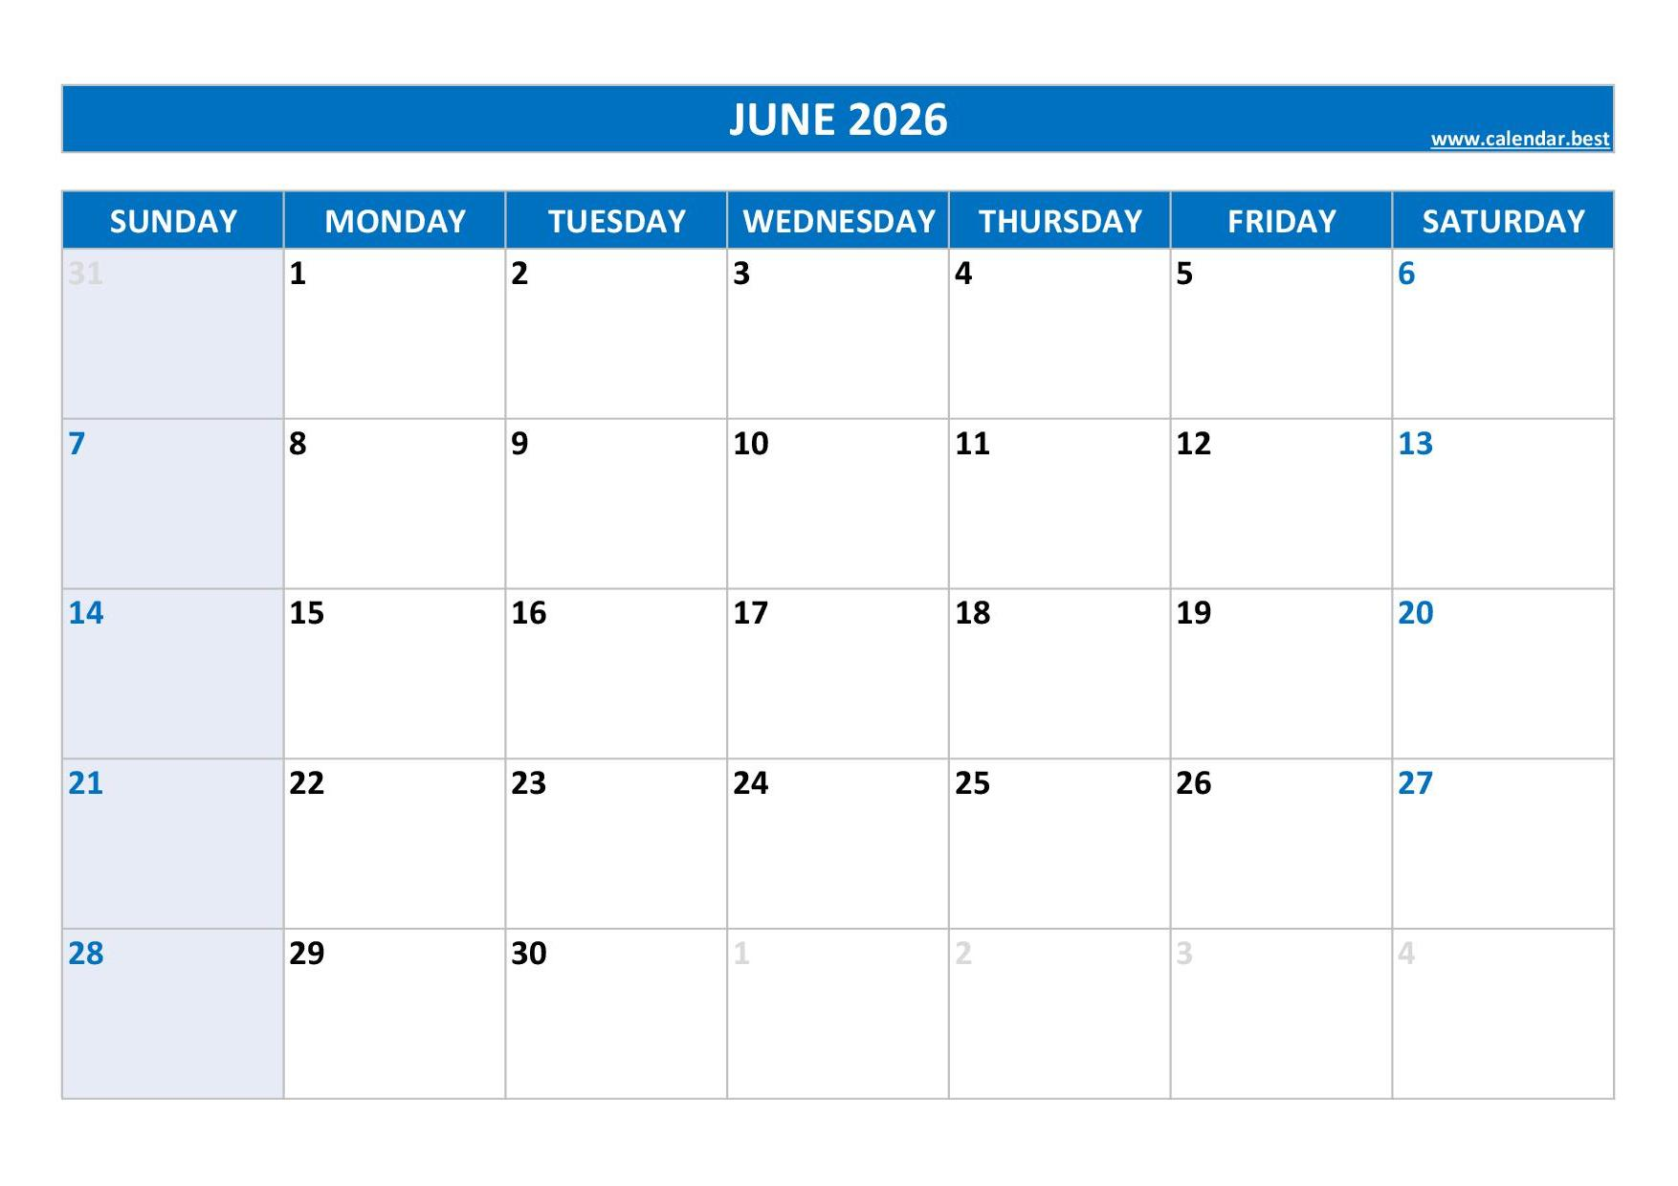
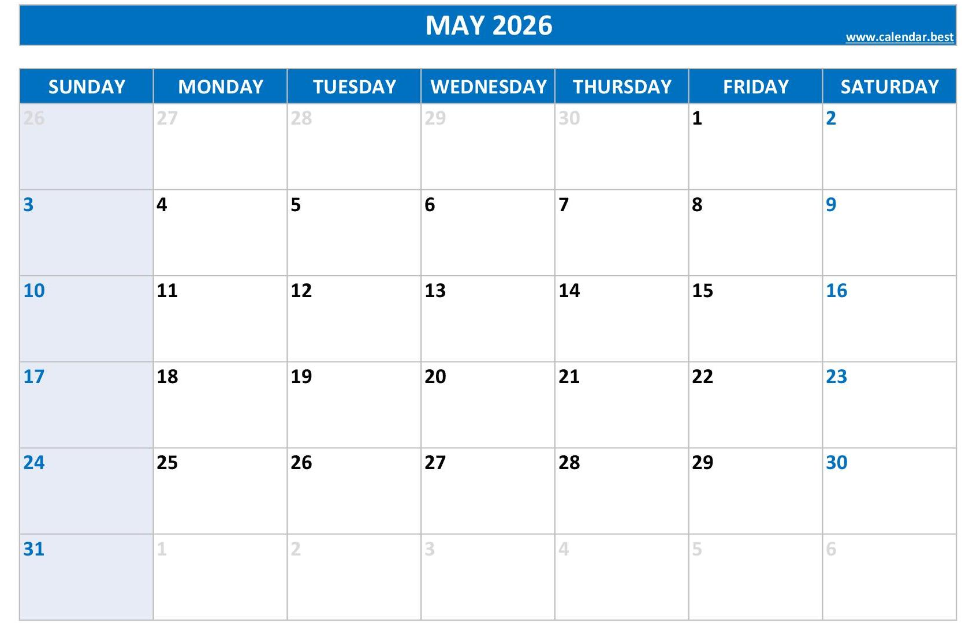
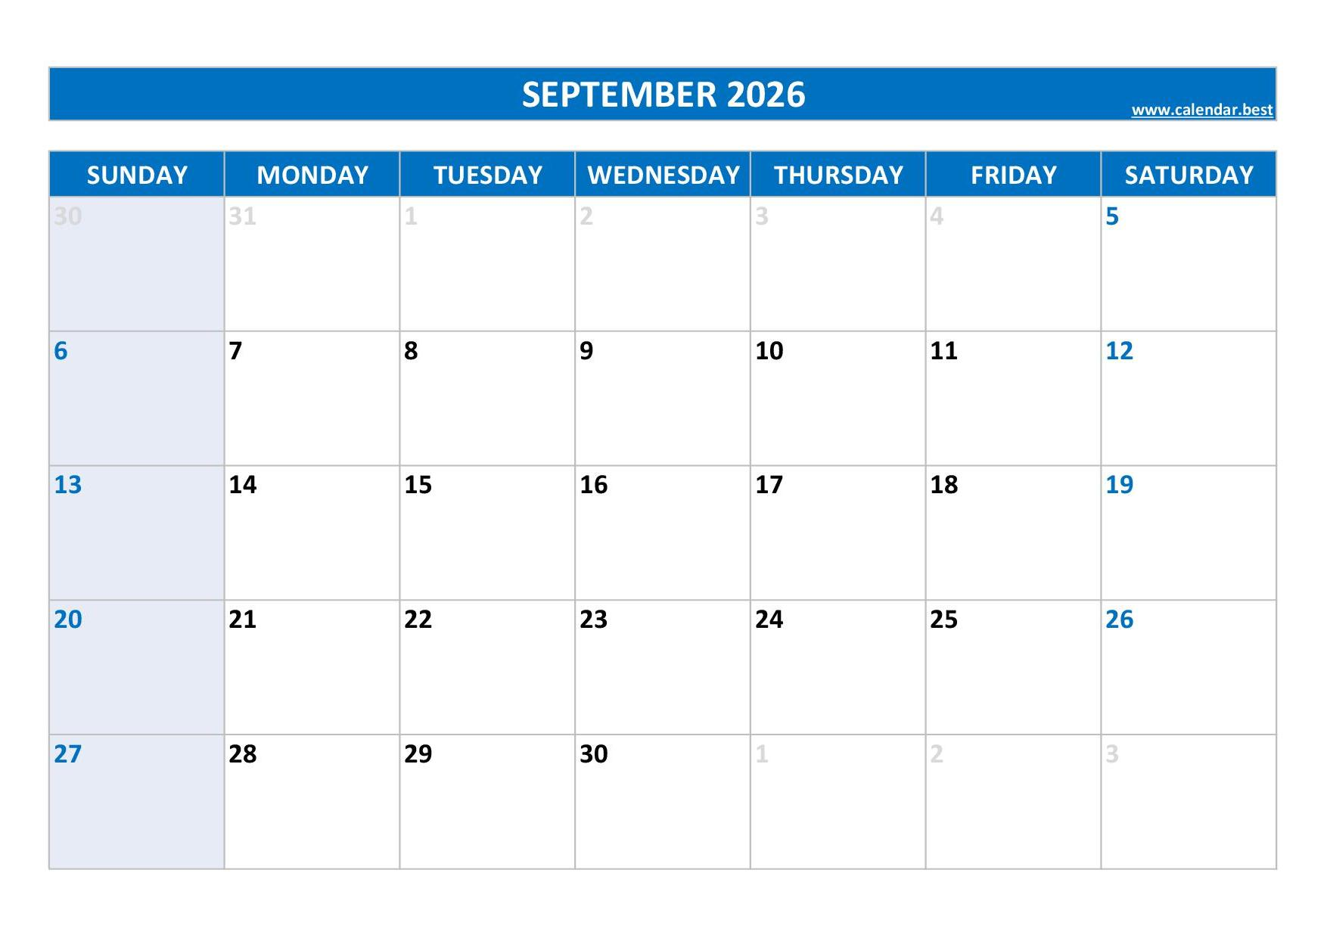
Important Dates - Application Period
Submission of summer internships files will be announced
Last day for submission of summer internships
Earliest day
Start your internship
Last day of
your
internship
22 May 2026 – Last Day for submission of summer internships
22 June 2026 – Earliest day to start your internship
12 September 2026 – Last day of your internship
Çankaya University – Dept. of Architecture ARCH 100-200-300 Internships / Spring 25-26 1/10

Slide 3


Before-During-After process
BEFORE
AFTER
Online application:
Fill the Google Forms
https://forms.gle/AH795coamzss4HLHA
2. Fill and sign then submit :
Çankaya University Compulsory Intern Student Insurance Application Form (Stajyer Öğrenci Sigorta Giriş Formu)
3. Fill and get signed then submit:
Letter of Acceptance (Kabul Belgesi)
4. SPAS Müstehalık belgesi
(download from e-devlet)
Submit and send a mail 2nd & 3rd items to related Res. Assist.
Finish writing your internship report
Upload your final report in .pdf format to Webonline page
Submit get Filled and signed;
-Student evaluation form
-Authenticity Form
-Unemployment Fund Contribution to Internship Salary Form
Submit 2nd item in sealed and signatured envelope to related Res. Assist.
INTERNSHIP
-Record the process
-Key concerns
Çankaya University – Dept. of Architecture ARCH 100-200-300 Internships / Spring 25-26 2/10

Slide 4
Before the internship
Summer Internships
ARCH100
-Construction Sites;
-Rough construction
-Reinforced concrete implementations
ARCH200
-Construction Sites;
-Rough&finish construction
-Reinforced concrete implementations
-Detail implementations
ARCH300
-Architectural offices
in offices dealing with diverse and large scale projects
or…
-Archaeological sites
Find a suitable process for your internship
Start fill the Google Form via using the link provided at the websites:
https://forms.gle/AH795coamzss4HLHA
Çankaya University – Dept. of Architecture ARCH 100-200-300 Internships / Spring 25-26 3/10

Slide 5
Before the internship
Don’t forget:
The duration of the internship is 30 work days
(consider weekdays and national holidays-Kurban Bayramı, 15 Temmuz, 30 Ağustos)
Students cannot arrange their internships in the firms which are owned by (or partnered by) themselves, their family.
Construction Inspection Firms (Yapı Denetim Şirketi) are not suitable for the internships
Doing internships in the same spaces with your classmates is not forbidden but be careful writing your reports!
Çankaya University – Dept. of Architecture ARCH 100-200-300 Internships / Spring 25-26 4/10

Slide 6
During the internship
!
Follow the instructions of you supervisor.
Main concerns for a construction site…
For the any kind for risks that threat your security of life at the construction site;
Get in contact with the Department of Architecture.
Keep your daily records during your practice.
Çankaya University – Dept. of Architecture ARCH 100-200-300 Internships / Spring 25-26 5/10

Slide 7
After the internship
Preparation and Submission of Summer Practice File
Download the template report from websites;
arch100.cankaya.edu.tr
arch200.cankaya.edu.tr
arch300.cankaya.edu.tr
Prepare your report indicated as in the Manual
Upload your report webonline course page
Submit your envelope to related Res. Assist.
AVOID PLAGIARISM: The work of only yourself !
Çankaya University – Dept. of Architecture ARCH 100-200-300 Internships / Spring 25-26 6/10

Slide 8
About Internship Report
MAIN BODY
i. Time period and date of the summer practice
ii. Information about the company
iii. Daily worktable of the summer practice period
iv. Student comments
DAILY RECORDS (can be written in Turkish)
Çankaya University – Dept. of Architecture ARCH 100-200-300 Internships / Spring 25-26 7/10

Slide 9

Reminder
Follow the announcements from
Webpage:
arch100.cankaya.edu.tr
arch200.cankaya.edu.tr
arch300.cankaya.edu.tr
arch.cankaya.edu.tr
Departmental Webpage:
Webonline
Çankaya University – Dept. of Architecture ARCH 100-200-300 Internships / Spring 25-26 8/10

Slide 10
Unsatisfactory conditions
!
The major problems that make your internship “Unsatisfactory” are;
-Cheating / Plagiarism: If the visual or written content is same or similar, if the written content is “paraphrased”.
-Missing Form of Authenticity or no stamp /signature on the pdf the scan of the file
-Missing “Student Evaluation Form”
-Lack of information
-Inconsistency between written content and visual content
-Internships less than 30 work days.
-Missing or too short conclusion part.
-Missing information (Instruction Manuel should be taken into account), or folders arranged out of format.
Çankaya University – Dept. of Architecture ARCH 100-200-300 Internships / Spring 25-26 9/10

Slide 11

Important Dates - Application Period
Questions & Answers
Çankaya University – Dept. of Architecture ARCH 100-200-300 Internships / Spring 25-26 10/10

